Slide 1
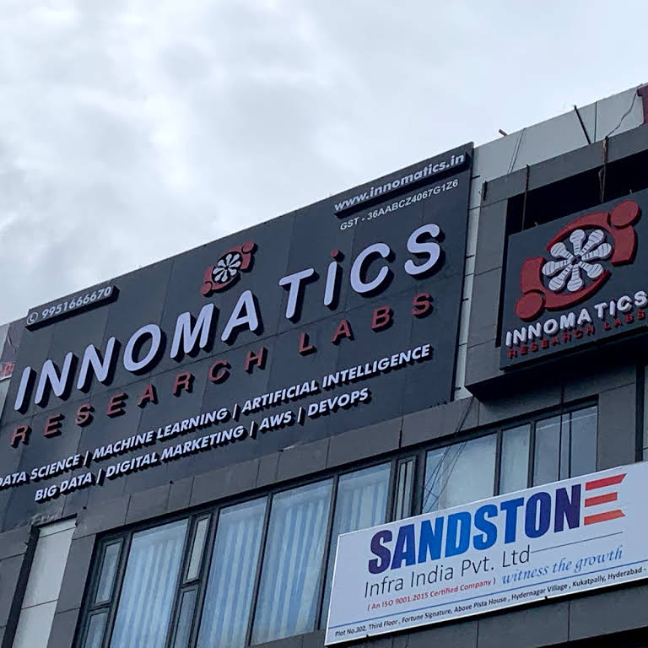
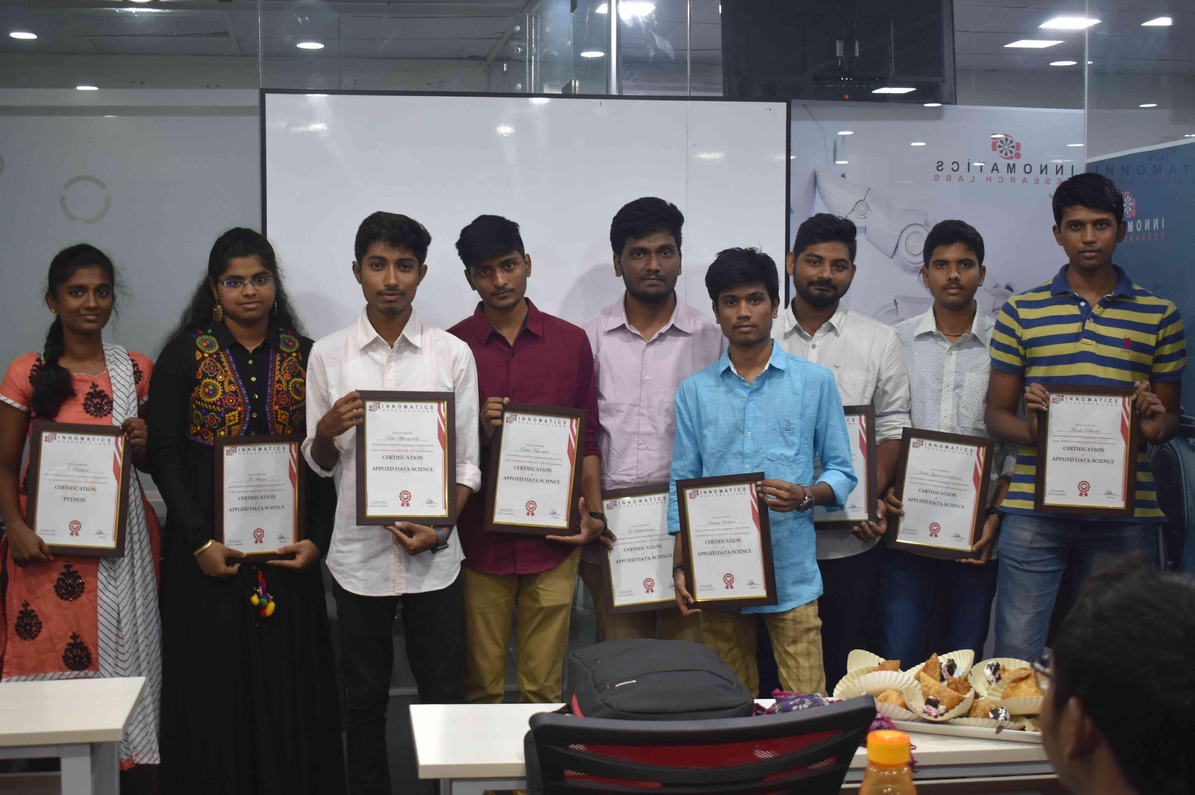
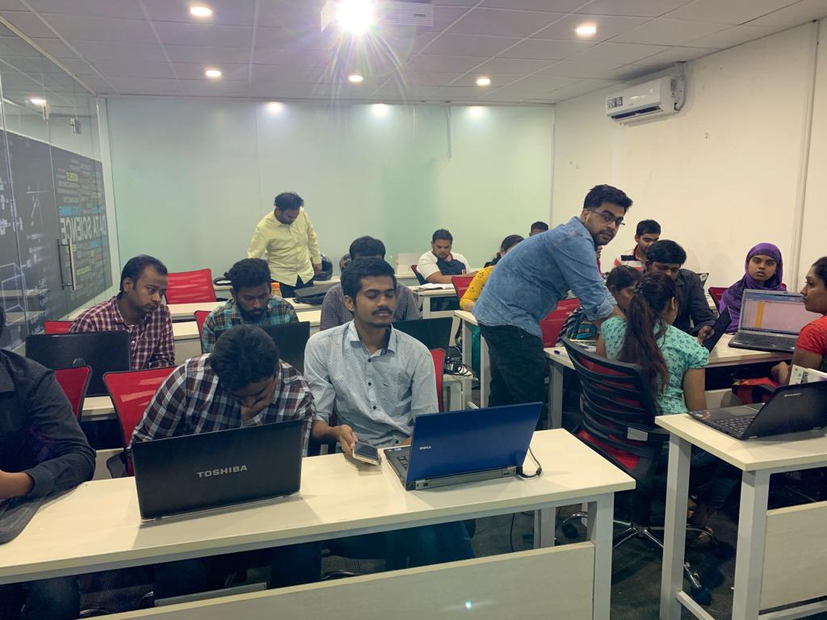

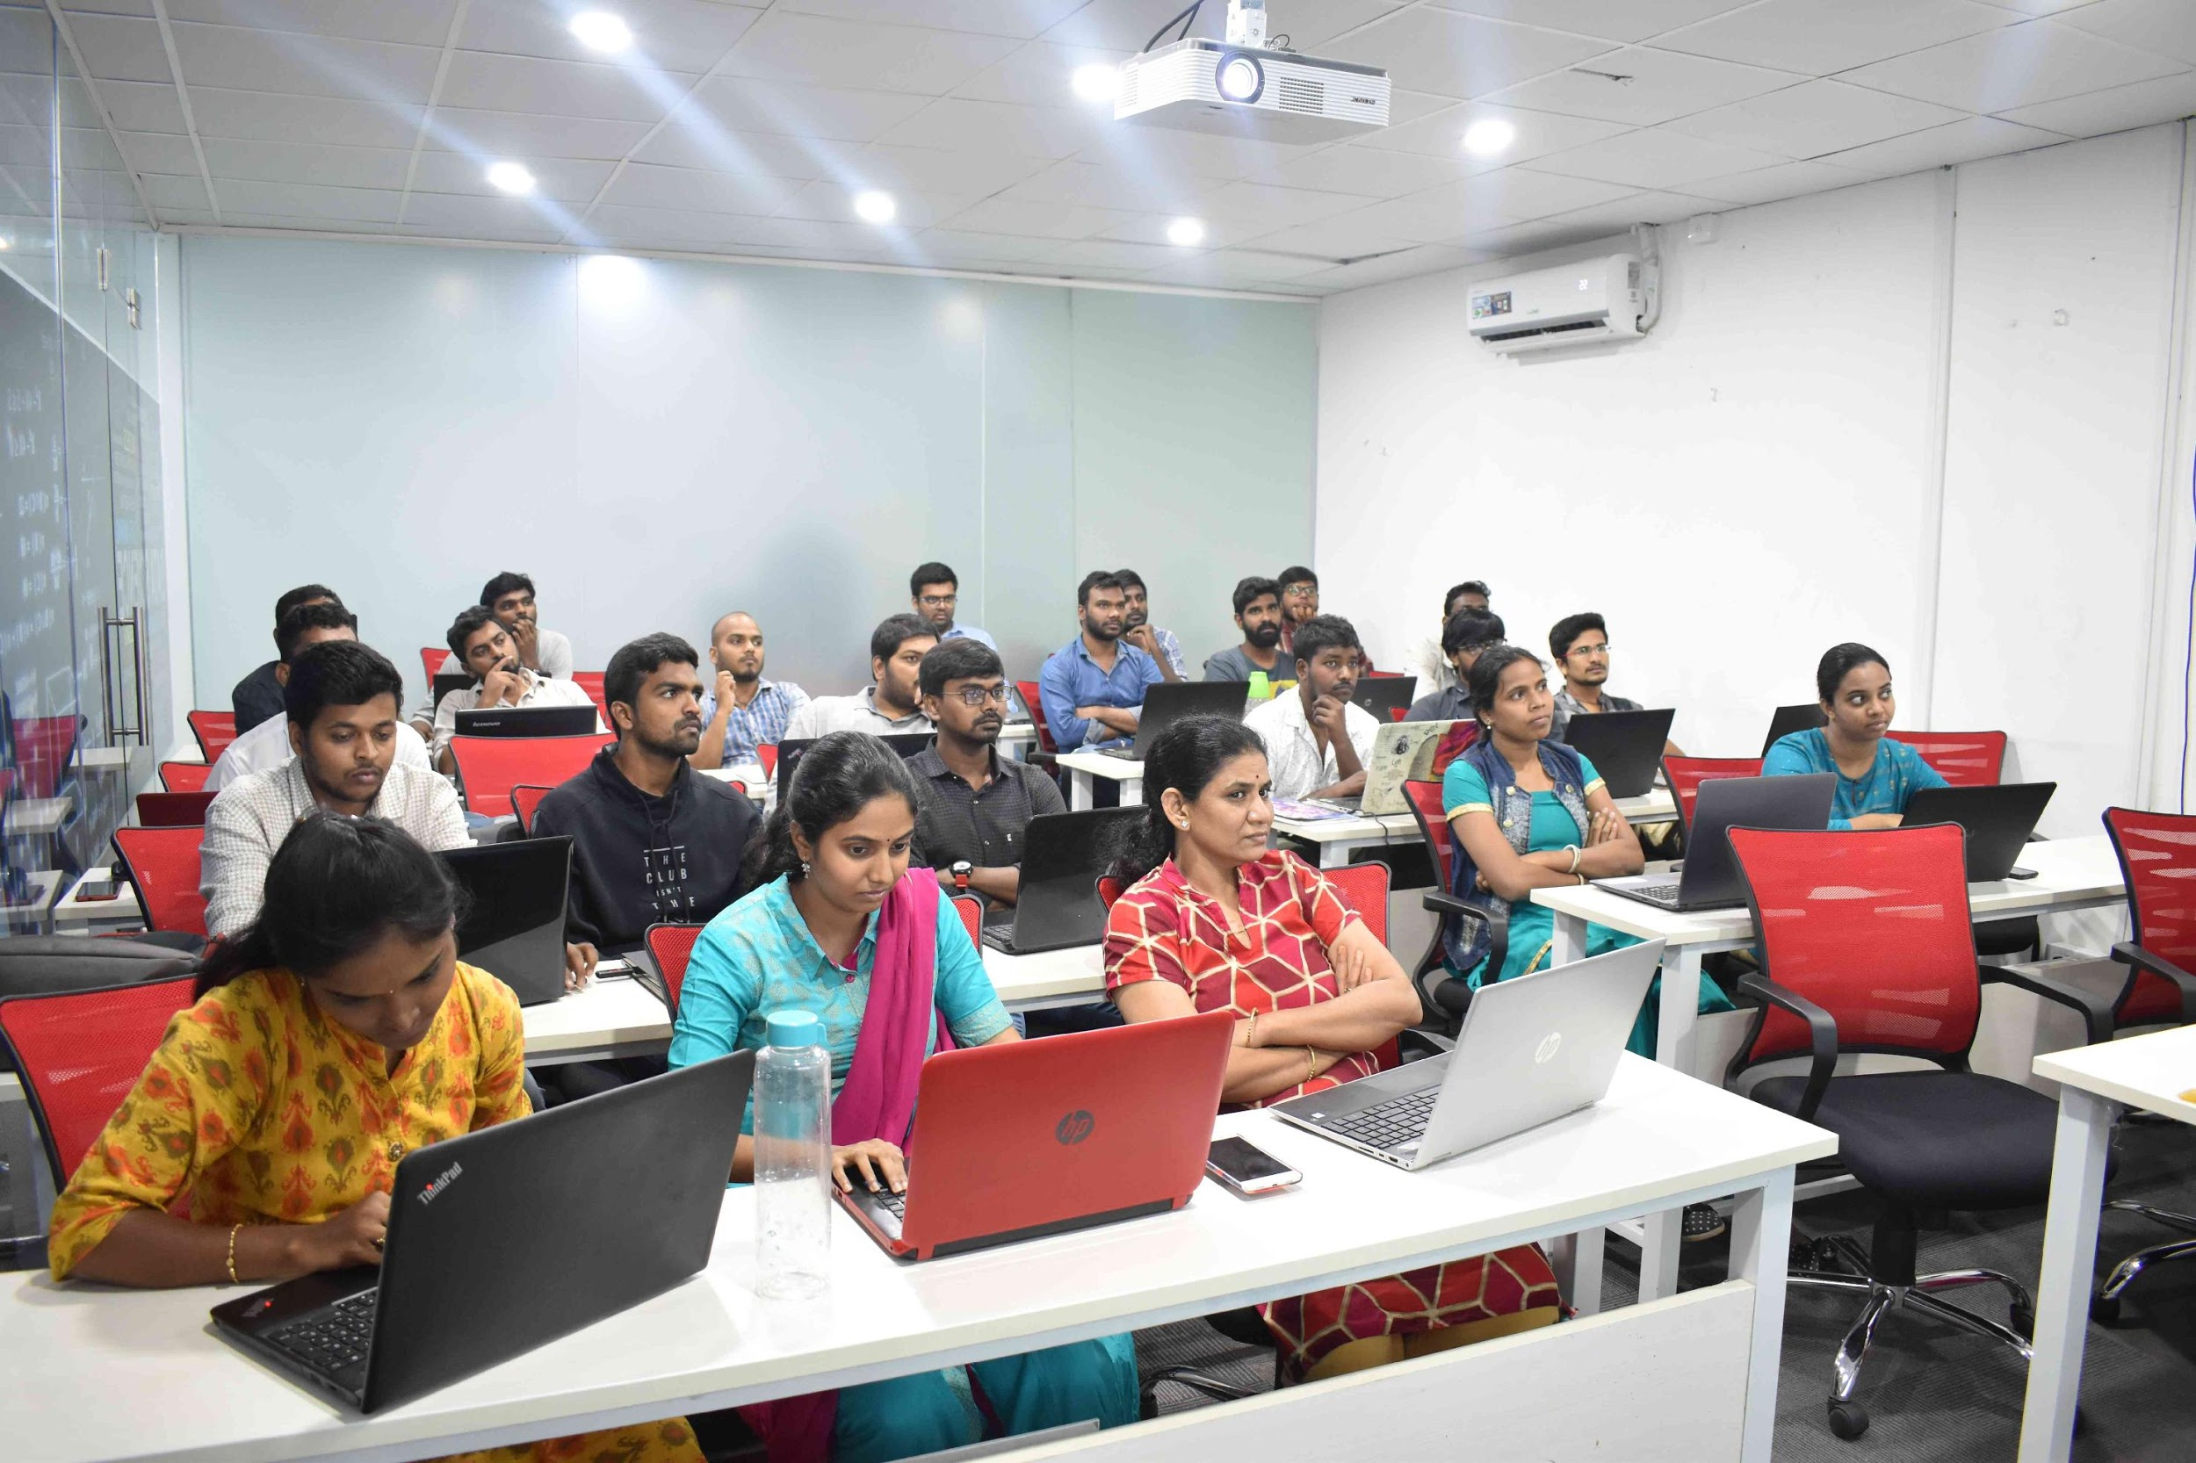
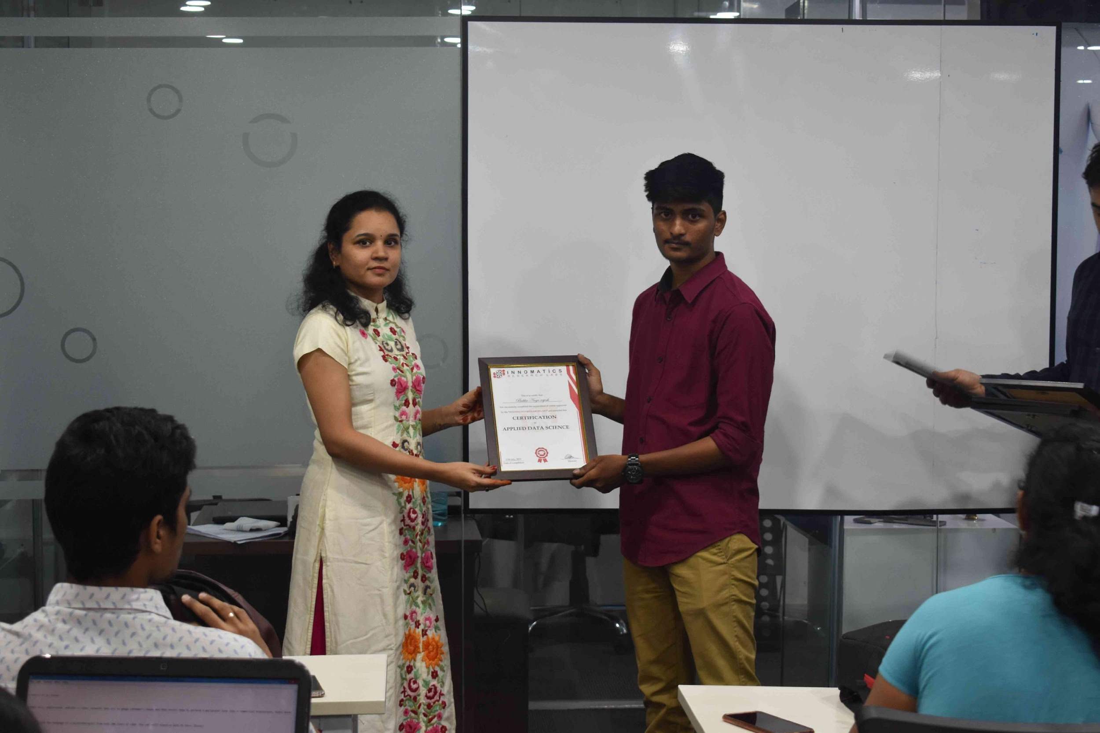
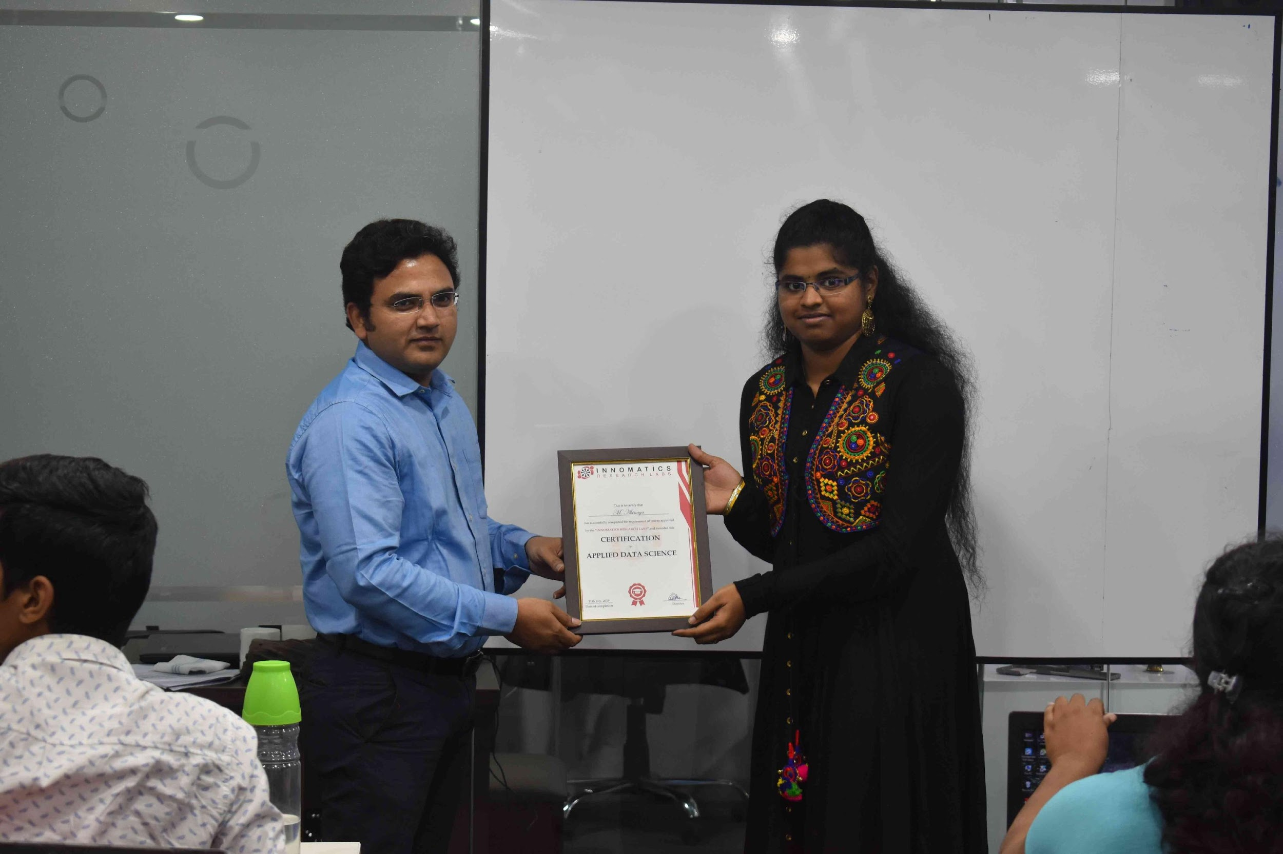

Slide 2
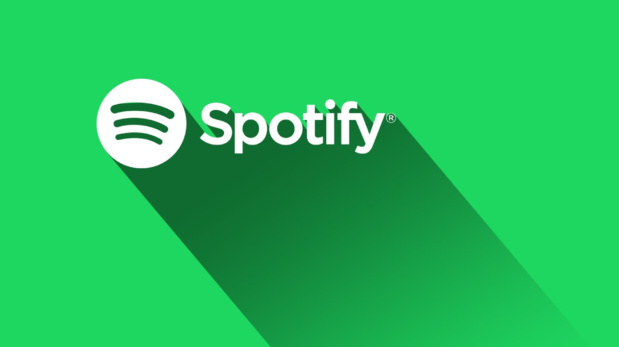

Clone App
By
SAILESH T

Slide 3
About me
Background ? (B-tech or M-tech)
I am from B-tech in Computer Science Engineering pursuing Final Year (2022-pass out).
Why you want to learn Full Stack Development Course
I was intrested in coding, So as a fresher I have been chosen that it’s best way to start my career with Full stack development.
Any work experience
No work Experience.(Fresher)
What like you about Innomatics Research lab
The way of teaching, and they teach in mostly in practical way.

Slide 4
Project Presentation Flow
Project Title: Spotify Clone Application
Project Description: With Spotify, you can play and listen to millions of songs for free! Listen to artists you love and enjoy music in multiple languages.
Technologies Used:
HTML
CSS
JavaScript
DOM
Bootstrap 5.2
AJAX (XMLHTTPRequest)

Slide 5
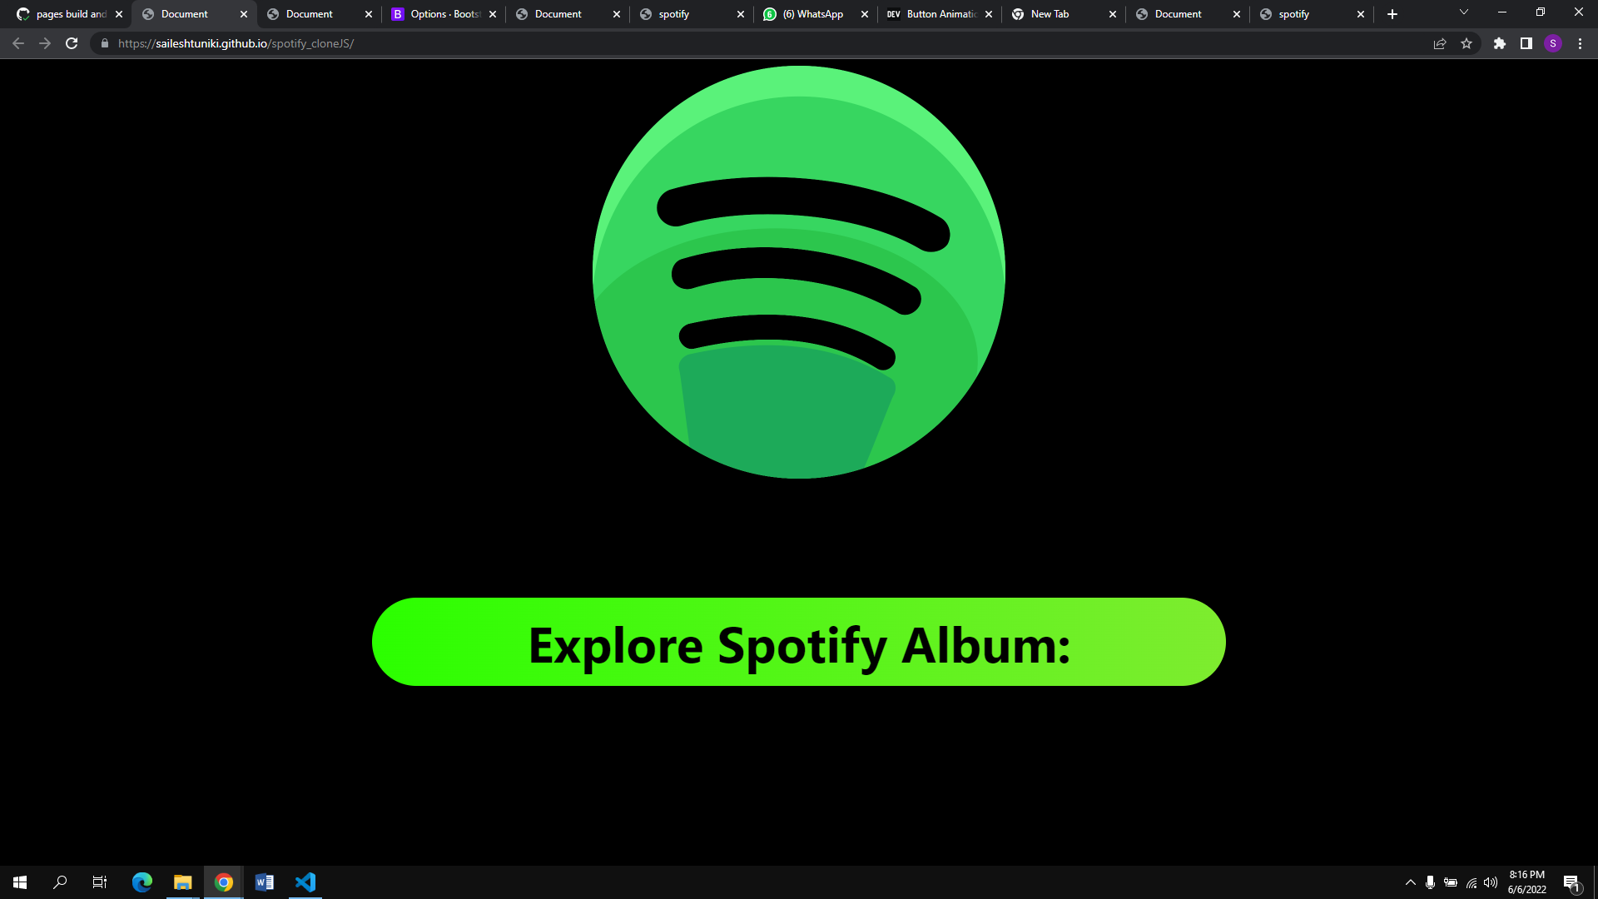
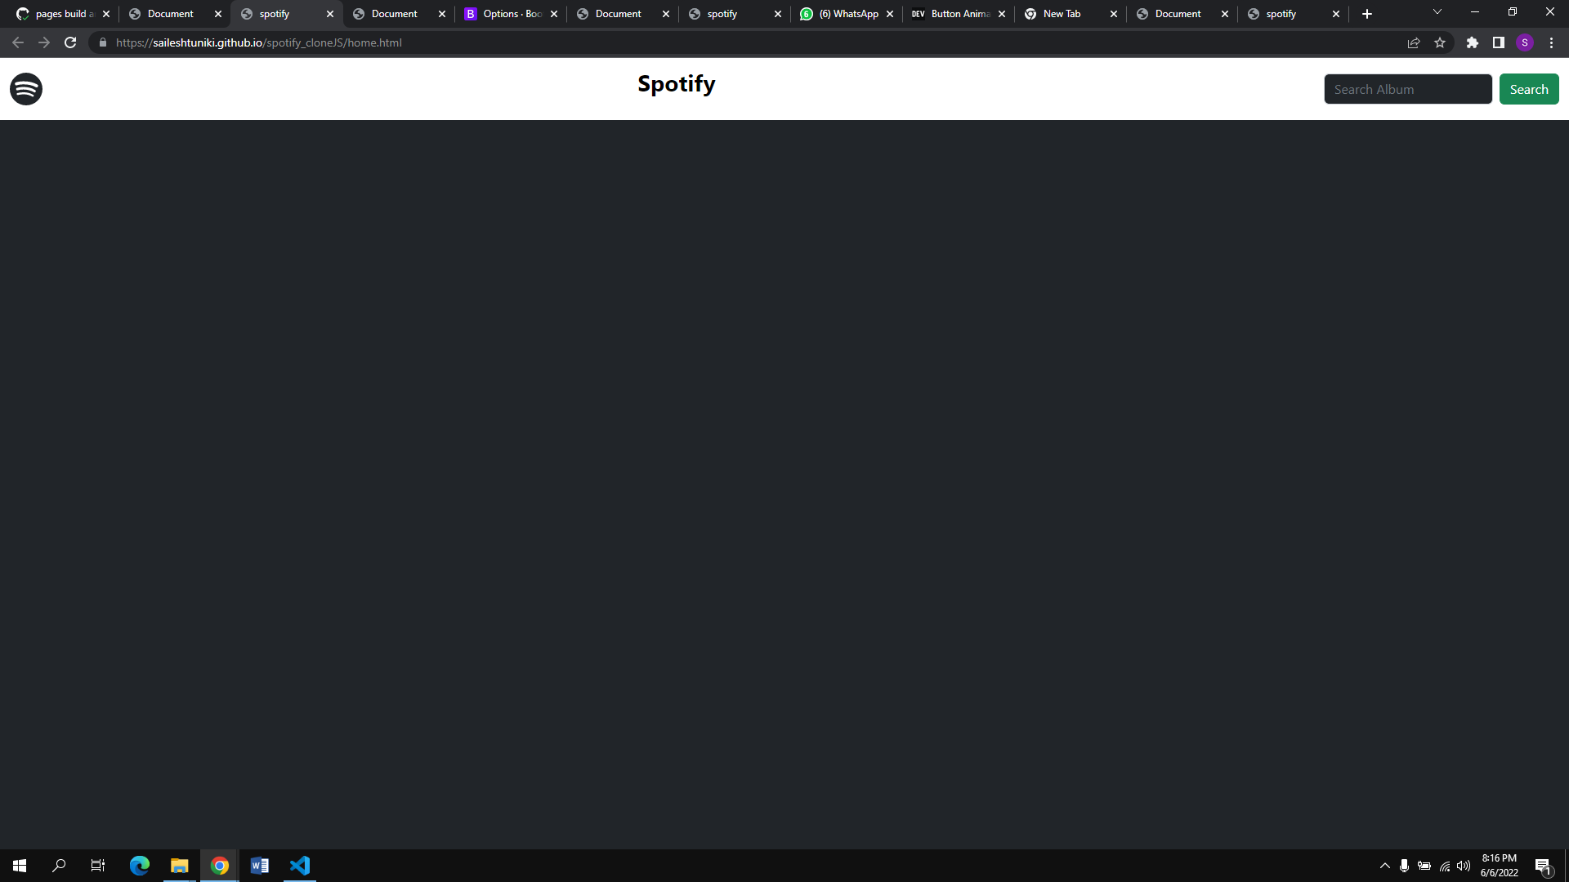
Screenshots of the Application
Main Page
Search Page

Slide 6
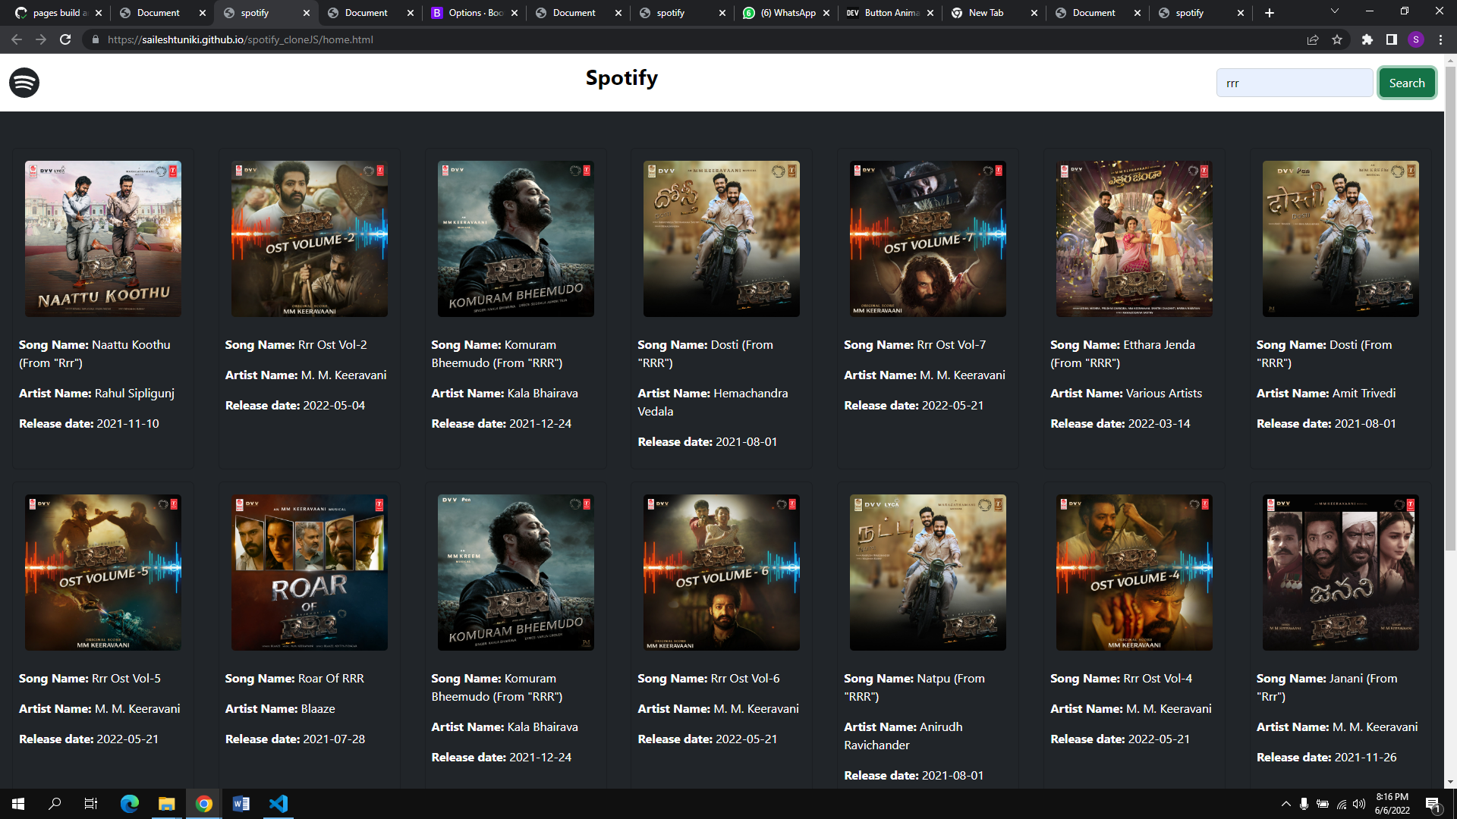
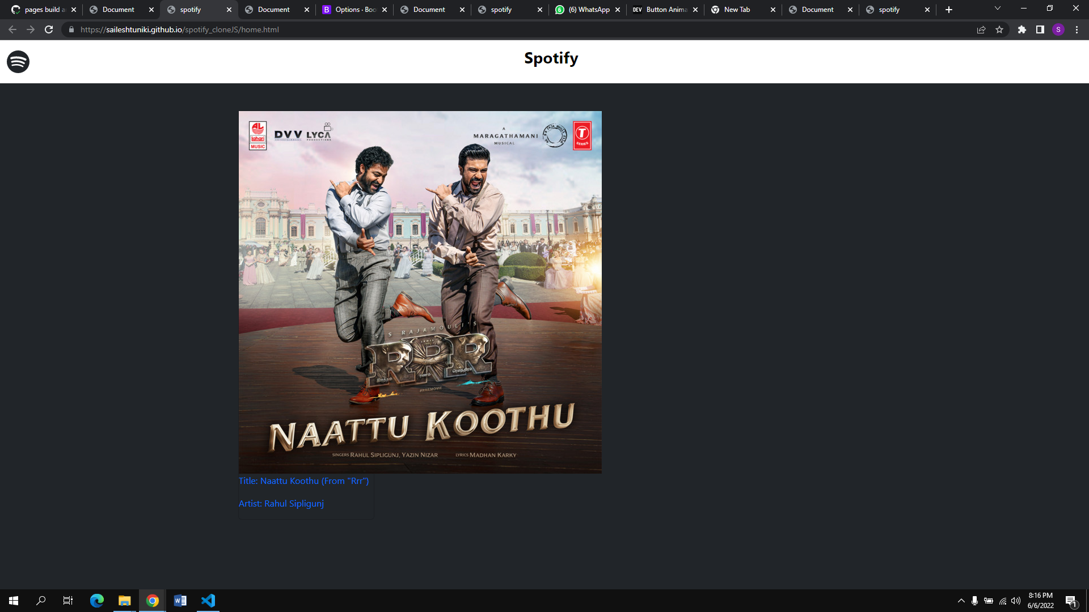
Result Screenshots

Slide 7
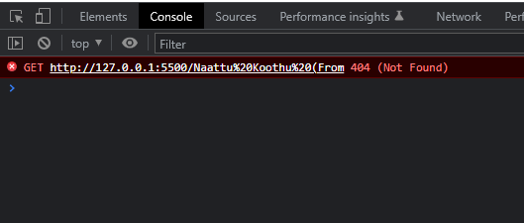
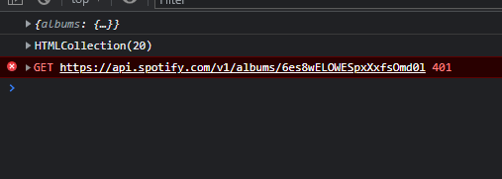
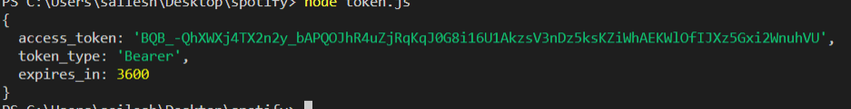
Challenges in Building the Project
It's been a bit challenging in some areas, especially in the coding segment by grasping ideas, and in others. It’s also been difficult in some issues and finding solutions from various resources, which has helped me a lot in problem solving.

Slide 8
Experience in Building the Project
Building this application was a great learning experience for me in terms of understanding the concepts. As a result, I'll be able to complete more projects.

Slide 9

THANK YOU!

